Slide 1
EMPLOYEES AND EMPLOYMENT TRENDS
MPU 3362 & Version 1
ATTITUDES

Slide 2
CLASS RULES
PLEASE BE PUNCTUAL
For online classes, you must ‘on’ the audio & camera whenever you speak
When you are not speaking, please mute your audio and off the camera.
Please use the chat option to communicate with lecturer and classmates whenever required
Participate actively during class.
Ensure you have scanned your attendance.
Always check your Microsoft Teams for any updates.

Slide 3
Topic & Structure of The Lesson
Definition of attitude
Significance of good attitude
Good attitude atmosphere
Effect of attitude at work place
Slide ‹<number>› of 9

Slide 4
Learning Outcomes
At the end of this topic, You should be able to
Discuss the good attitudes and its significance
Explain the attitudes and characters of successful employees
Slide ‹<number>› of 9

Slide 5
Key Terms You Must Be Able To Use
If you have mastered this topic, you should be able to use the following terms correctly in your assignments and exams:
Attitude
Behaviour
Positive attitude
Negative attitude
Slide ‹<number>› of 9

Slide 6
Activity 1:
Positive outlook activity
Slide ‹#› of 9

Slide 7
Introduction
A complex mental state involving beliefs and feelings and values and dispositions to act in certain ways.
(Princeton University)
An attitude is an expression of favor or disfavor toward a person, place, thing, or event (the attitude object).
Prominent psychologist Gordon Allport once described attitudes "the most distinctive and indispensable concept in contemporary
6 - <number>
Copyright © Houghton Mifflin Company. All rights reserved.

Slide 8
DEFINITION OF ATTITUDE
Definition of attitude “A Psychological tendency that is expressed by evaluating a particular entity with some degree of favor or disfavor."
Common to define an attitude as affect toward an object, affect (i.e., discrete emotions or overall arousal) is generally understood to be distinct from attitude as a measure of favorability.
Slide ‹<number>› of 13

Slide 9
Significance
Your attitude is a form of expression of yourself.
You can choose to be happy, positive and optimistic or you can choose to be pessimistic and critical with a negative outlook on your workday.
Positive thinking and a good attitude help better your psychological well being
Help you cope better under stressful situations at work.
Making it easier to communicate and get along in the workplace.

Slide 10
Aspects of Attitudes
Can be changed or new ones learned
Not formed casually or quickly
Can motivate or cause to act
One can choose to act or not
Values serve as a foundation for attitudes
Copyright © Houghton Mifflin Company. All rights reserved.

Slide 11
Attitudes Can Shape Your Life
Impact of attitudes on success of individuals and organizations
Ways people acquire attitudes
Attitudes that employers value
Organizational efforts to develop positive employee attitudes
6 - <number>
Copyright © Houghton Mifflin Company. All rights reserved.

Slide 12
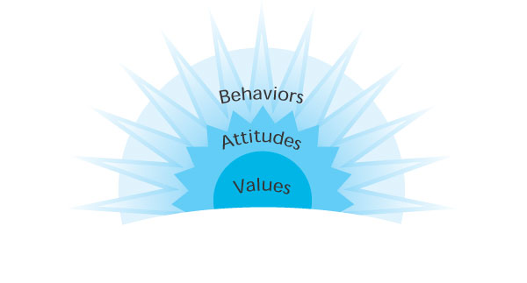
Figure 6.1
The Relationship Among
Values, Attitudes,
and Behaviors
Copyright © Houghton Mifflin Company. All rights reserved.

Slide 13
ATTITUDE STRUCTURE
An attitude contains cognitive, affective, and behavioural components.
A criticism of the tripartite view of attitudes is that it requires cognitive, affective, and behavioural associations of an attitude to be consistent, but this may be implausible.
Slide ‹<number>› of 13

Slide 14
POSITIVE ATTITUDE
Positive attitude helps you cope more easily with the daily affairs of life.
It brings optimism into your life, and makes it easier to avoid worry and negative thinking.
With a positive attitude you see the bright side of life, become optimistic, and expect the best to happen.
Slide ‹<number>› of 13

Slide 15
POSITIVE ATTITUDE MANIFEST IN THE FOLLOWING WAYS:
Positive thinking.
Constructive thinking.
Creative thinking.
Expectation of success.
Optimism.
Motivation to accomplish your goals.
Being inspired.
Slide ‹<number>› of 13

Slide 16
NEGATIVE ATTITUDE
A negative attitude is characterized by a great disdain for everything.
Someone who constantly points out the negative in everything.
A negative attitude is contagious and therefore avoiding people with one is the best way of prevention.
Once you have a negative attitude, you will unlikely be able to recover and self fulfilling prophecy takes a hold.
Slide ‹<number>› of 13

Slide 17
Root Causes of Negative Attitudes
Low self-esteem
Unresolved conflict
Work that is not satisfying
Fear or uncertainly
6 - <number>
Copyright © Houghton Mifflin Company. All rights reserved.

Slide 18
The Powerful Influence of Attitudes
People with positive attitudes are more likely to achieve personal and professional goals
People with negative attitudes find it difficult to achieve contentment or satisfaction in life
6 - <number>
Copyright © Houghton Mifflin Company. All rights reserved.

Slide 19
Cont..
Suspicion and cynicism may have negative impact on employee-management relations
Trust and hope may result in improved worker morale, or improve communication and cooperation between an employee and a supervisor
6 - <number>
Copyright © Houghton Mifflin Company. All rights reserved.

Slide 20
Cont..
Care by an employee can increase customer loyalty and set the stage for repeat business
Attitudes are a powerful force in any organization

Slide 21
The Challenge of Change
Increased focus on teams rather than the traditional boss/subordinates hierarchy
Shifts from production- to information- economy
Growth in service-related jobs
Limited lifetime employment
6 - <number>
Copyright © Houghton Mifflin Company. All rights reserved.

Slide 22
How Attitudes Are Formed
Socialization
Peer and reference groups
Rewards and punishment
Role model identification
Cultural influences
6 - <number>
Copyright © Houghton Mifflin Company. All rights reserved.

Slide 23
Attitudes Valued by
Employers
Attitudes sought by employers :
  Self-motivation
  Openness to change
  Team spirit
  Health consciousness
  Appreciation of coworker diversity
  Honesty
  Respect
  Innovative ideas
6 - <number>
Copyright © Houghton Mifflin Company. All rights reserved.

Slide 24
Changing Your Own Attitude
Attitudes that help achieve positive results:
  Choose happiness
  Embrace optimism
  Think for yourself
  Keep an open mind
6 - <number>
Copyright © Houghton Mifflin Company. All rights reserved.

Slide 25

Helping Others Change Attitudes
Change the conditions that precede the behavior
Change the consequences that follow when the person exhibits the behavior
6 - <number>
Copyright © Houghton Mifflin Company. All rights reserved.

Slide 26
Organizational Efforts
Organizations realize employees’ attitudes and performance cannot be separated
Salaries and benefits traditional rewards
Today, workers want
  Respect
  Interesting work
  Recognition
  Skill development
Maintenance of positive attitudes helps productivity
Provide benefits that workers consider important
Find creative ways to influence worker attitudes
Copyright © Houghton Mifflin Company. All rights reserved.

Slide 27
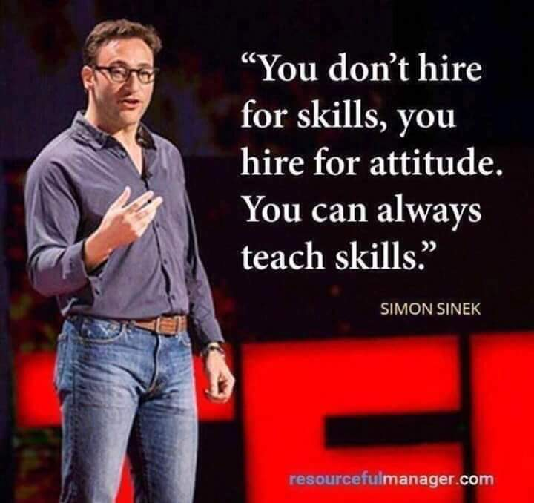
Slide ‹<number>› of 13

Slide 28
Quick Review Question
Tutorial Activity:
https://www.youtube.com/watch?v=twpIw4_xaH0
https://www.youtube.com/watch?v=dODHxdG0ny8
From the video:
List down on unprofessional action spot in the video.
Discuss on professional way the employees should act.
Slide ‹<number>› of 13

Slide 29
Summary of Main Teaching Points
Organizations are taking steps to improve employee attitudes by enhancing the quality of their work life.
Individuals have power to choose attitudes.
Slide ‹<number>› of 9

Slide 30
Summary of Main Teaching Points
Attitudes are acquired through:
  Early childhood socialization
  Peer and reference groups
  Rewards and punishments
  Role model identification
  Cultural influences
Employers hire and retain people who:
  Are self-motivated
  Are self-directed learners
  Are willing team players
  Are concerned about their own health and wellness
  Value coworker diversity
6 - <number>
Copyright © Houghton Mifflin Company. All rights reserved.

Slide 31
Question and Answer Session
Q & A
Slide ‹<number>› of 9

Slide 32
What we will cover next
Identify the self Strength
Slide ‹<number>› of 9

